Slide 1

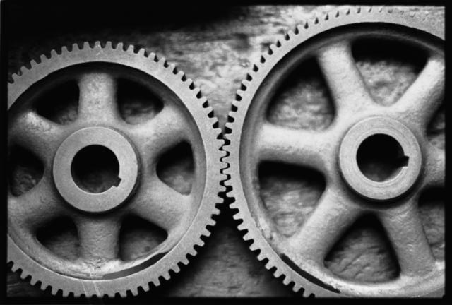
GEN
REQUIREMENTS
AC Bus
AC1
AC2
AC3
TRU
DESIGN
SYSTEM LEVEL MODEL
DETAILED
Mechanical
Electrical
Electrical
DC Bus
Control
ϕ
DC1
DC2
DC3
Batt
Aircraft Power Network Development with Model-Based Design
Steve Miller
Technical Marketing, Physical Modeling
MathWorks
http://www.mathworks.com/physical-modeling/

Slide 2
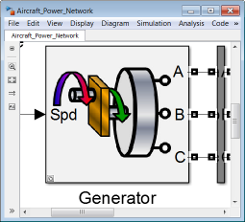
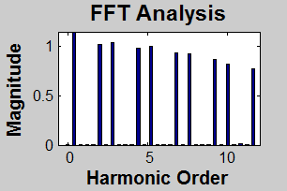
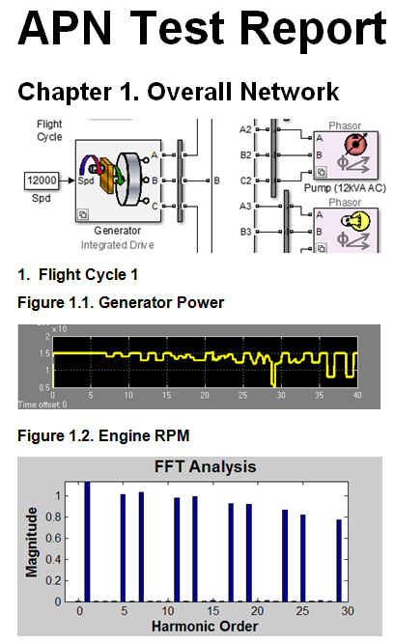
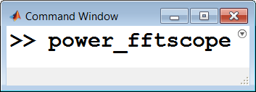
Key Points
Computational Time vs. Model Complexity
Configure your model to balance model fidelity and simulation speed
Accelerate your simulations using optimization algorithms and parallel computing
Accelerate your development by automating simulation and analysis tasks using MATLAB®
Computational
Time
Detail
Multi
Core
Network Model

Slide 3
Agenda
Overview: Aircraft Power Network Model
Simulation goals
Development process
Initial Design
Linking to requirements
Refining requirements
Detailed Design
Generators, loads
Harmonic analysis
Integrating other domains
Tuning Abstract Model
Documenting Results

Slide 4
Aircraft Power Network System for Analysis
Half-aircraft model
One generator
AC bus with loads
TRU (Transformer- Rectifier Unit)
DC bus with loads and battery
Breakers open and close during flight cycle
DC Bus
Batt
TRU
AC Bus
GEN
DC1
AC1
APU
DC2
AC2
GEN
DC3
AC3
External Power
Not modeled
Breaker

Slide 5
Aircraft Power Network Simulation Goals
Determine power requirements
Generator, loads, battery
Power lines
Analyze system interactions
Electrical, mechanical, hydraulic, thermal, etc.
Perform harmonic analysis
Varying conditions
Voltage and current at different nodes in network
DC Bus
Batt
TRU
AC Bus
GEN
DC1
AC1
APU
DC2
AC2
GEN
DC3
AC3
External Power
Not modeled
Breaker

Slide 6
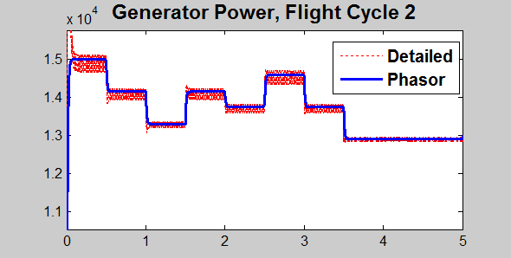
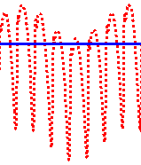
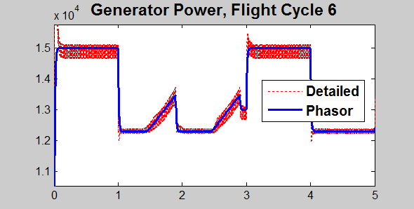
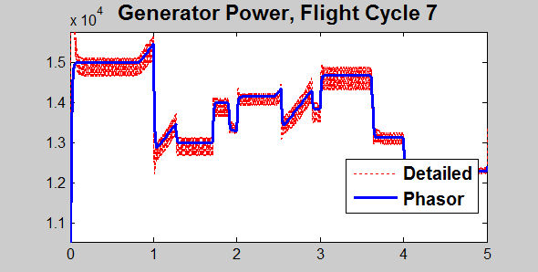
Aircraft Power Network Simulation Results
Results from system-level and detailed models match
Enables rapid iteration at system level and detailed analysis of electrical system

Slide 7
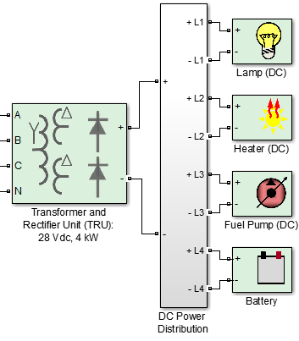
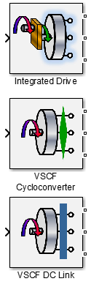
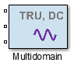
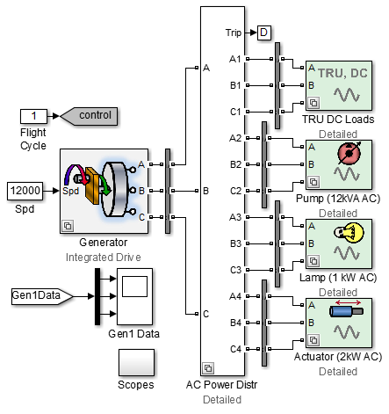
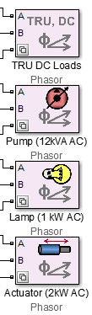
Aircraft Power Network Simulation Model
Generator
Integrated Drive
VSCF Cycloconverter
VSCF DC Link
AC Loads
Detailed
Abstract
DC Loads
Detailed
Abstract
Multidomain

Slide 8
Balancing Fidelity and Simulation Speed
Key to effective use of simulation
Capture only the effects you need
Configure the model for your task
MathWorks products enable you to select the right level of detail for your task
Computational Time vs. Model Complexity
Power
Electronics
Realistic Loads
Computational Time
PWM Control
Abstract Loads
Phasor Simulation
Averaged Voltage
Model Complexity & Detail
Configure your model to balance simulation speed and model fidelity.

Slide 9
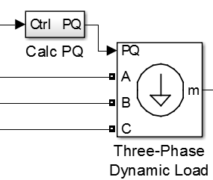
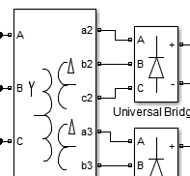
Balancing Fidelity and Simulation Speed System and Component Level Design
Design process requires abstract and detailed models
Refine requirements (system level)
Design component
Combine as necessary
Tune abstract model for rapid simulation
System and detailed models are complementary
Match level of detail to simulation task
REQUIREMENTS
1
2
SYSTEM LEVEL MODEL
DETAILED
Mechanical
Electrical
Electrical
Control
ϕ
3
4

Slide 10

Airbus Develops A380 Fuel Management System Using Model-Based Design
Challenge
Develop a controller for the Airbus A380 fuel management system.
Solution
Use MATLAB and Simulink to model and simulate the control logic, communicate the functional specification, and accelerate the development of simulators.
Results
100,000 tests run in parallel each weekend
Months of development time eliminated
Models reused throughout development
Additional complexity handled without staff increases
“Model-Based Design gave us advanced visibility into the functional design of the system. We also completed requirements validation earlier than was previously possible and simulated multiple simultaneous component failures, so we know what will happen and have confidence that the control logic will manage it.”
Christopher Slack Airbus
Link to user story
Notes:
Primary Industry: Aerospace and Defense
Secondary Industries: N/A
Product Capabilities: Mathematical modeling, Algorithm development, Parallel computing, System design and simulation, Physical modeling, Verification, validation, and test
Applications: Embedded systems, Control systems, Digital signal processing
Products Used: MATLAB, Simulink, Curve Fitting Toolbox, MATLAB Distributed Computing Server, Parallel Computing Toolbox, Signal Processing Toolbox, SimPowerSystems, Simulink Coder, Stateflow, System Identification Toolbox
Country: United Kingdom
Airbus Develops Fuel Management System for the A380 Using Model-Based Design
The Airbus A380, the largest commercial aircraft currently in operation, has a range of more than 8,000 miles. To enable such long non-stop flights, the A380’s 11 fuel tanks have a capacity of 250 metric tons (320,000 liters).
The A380’s sophisticated fuel management system handles fueling and defueling operations on the ground, as well as fuel flow to engines and between tanks while airborne. The system can move fuel between tanks to optimize the aircraft’s center of gravity, reduce wing bending, and keep fuel within the acceptable temperature range.
Airbus engineers used Simulink® and Stateflow® to develop a model of the fuel management system that was reused throughout the project. “With Model-Based Design, the model we used to represent the functional specification enabled us to validate requirements months earlier than was previously possible,” says Christopher Slack, computational analysis expert in fuel systems at Airbus.
The Challenge
The A380’s fuel management system must be able to safely handle any failure in the system’s 21 pumps, 43 valves, and other mechanical components. In a complex system, it’s challenging for engineers at the requirements stage to predict any problem that can result from combinations of relatively minor failures.
The fuel system specification document for the A380’s predecessor, the A340, had over a thousand written requirements. “Text requirements can leave room for ambiguity and misinterpretation. When you have that many requirements, it’s difficult for anyone to understand all the possible interactions between them and identify, for example, that a requirement on page 20 conflicts with one on page 340,” says Slack.
“Model-Based Design gave us advanced visibility into the functional design of the system. We also completed requirements validation earlier than was previously possible and simulated multiple simultaneous component failures, so we know what will happen and have confidence that the control logic will manage it.”
- Christopher Slack, Airbus
The Solution
Airbus used Model-Based Design to model the A380’s fuel management system, validate requirements through simulation, and clearly communicate the functional specification.
Airbus engineers used Simulink and Stateflow to model the system’s control logic, which comprises 45 top-level charts, almost 6000 states, and more than 8700 transitions. This model defines modes of operation on the ground (including refuel, defuel, and ground transfer) and in flight (including normal engine feed, center of gravity control, load alleviation, and fuel jettison).
The functionality within each top-level mode is grouped into subcharts, enabling engineers to work independently on individual components in the hierarchy.
The team developed a parameterized plant model of the tanks, pumps, valves, and electrical components using Simulink. Engineers can set parameter values to configure this model to represent fuel systems for any Airbus aircraft.
After running closed-loop simulations of individual operational components in Simulink, the team integrated them into a complete model for system-level simulations.
Using Parallel Computing Toolbox™ and MATLAB Distributed Computing Server™, the team performed Monte Carlo simulations on a 50-worker computing cluster. Over a weekend, they can run 100,000 simulated flights under varied environmental conditions and aircraft operational scenarios.
The team created a desktop simulator by generating code from the plant and control logic models with Simulink Coder™. A MATLAB® based user interface enables suppliers, airline customers, maintenance engineers, and other Airbus teams to visualize how the fuel management system works and interacts with other aircraft systems.
The team also used the Simulink models to develop hardware-in-the-loop (HIL) tests and commission their HIL testing rig well before the real hardware was available.
After successful flight tests of the A380, the team used System Identification Toolbox™ to tune their plant model using measured flight test data. They used Signal Processing Toolbox™ to remove noise from the test data, and Curve Fitting Toolbox™ to evaluate differences between the measured data and predicted results and to predict system performance beyond the usual flight envelopes. While refining the plant model, they used SimPowerSystems™ to incorporate relays and other elements of the electrical power system.
Based on the success of implementing Model-Based Design for the A380, Airbus engineers are now using this approach to develop the Airbus A350XWB’s fuel management system, reducing development time of this aircraft by one year.
The Results
■ Months of development time eliminated. “On earlier projects, it took up to nine months to integrate our fuel system design with the simulated cockpit, or iron bird. Using Model-Based Design on the A380, it took less than a month,” says Slack. “Similarly, by reusing the model to commission the HIL rig, we saved three months of development and shortened the time from initial concept to first flight.”
Models reused throughout development. “The Simulink and Stateflow models enabled us to validate requirements early and communicate the functional specification to our suppliers, complementing the written requirements in conformance with ARP 4754,” says Slack. “These models were reused to create desktop simulators, commission our HIL test rig, run on our virtual integration bench, and demonstrate system functionality to customers.”
Additional complexity handled without staff increases. “The fuel system of the A380 is three to four times more complex than that of the A340,” notes Slack. “Model-Based Design enabled us to handle a substantially more complex project with the same size engineering team.”
Learn more about Airbus: www.airbus.com

Slide 11
Agenda
Overview: Aircraft Power Network Model
Simulation goals
Development process
Initial Design
Linking to Requirements
Refining Requirements
Detailed Design
Generators, Loads
Harmonic analysis
Integrating other domains
Tuning Abstract Model
Documenting Results
REQUIREMENTS
1
2
SYSTEM LEVEL MODEL
DETAILED
Mechanical
Electrical
Control
ϕ
Electrical

Slide 12
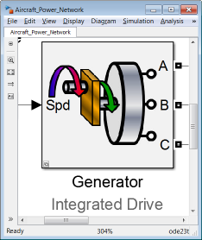
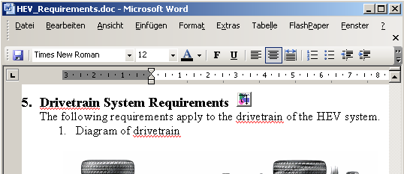
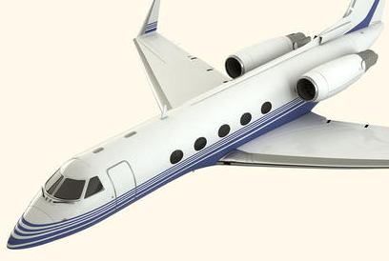
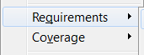
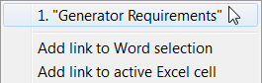
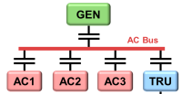
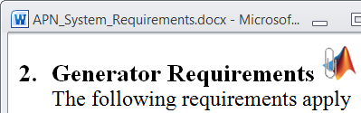
Linking Specification and Design
Situation:
Power Network Req.
1. Network Schematic
Part Numbers
Problem: Difficult to compare design and specification.
Solution: Use Simulink
Verification and Validation to link the design and specification.
Notes:
http://inside.mathworks.com/gallery/v/creativeservices/IndustriesAndApplications/AeroDef/Aircraft/jet_silo.jpg.html mw copyright own

Slide 13
Refining Requirements for Power Network
Operating, peak, and design loads for generators and lines
Wide range of network conditions
Neglect power electronic switching
Use abstract models and simulation methods
DC Bus
Batt
TRU
AC Bus
GEN
DC1
AC1
DC2
AC2
Power
Electronics
DC3
AC3
Realistic Loads
PWM Control
Loads On/Off
Computational Time
Flight Cycle 1
Abstract Loads
Phasor Simulation
Flight Cycle 2
Averaged Voltage
…
…
Hours
Model Complexity & Detail

Slide 14
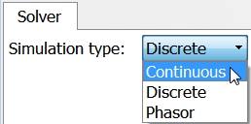
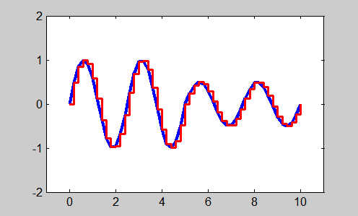
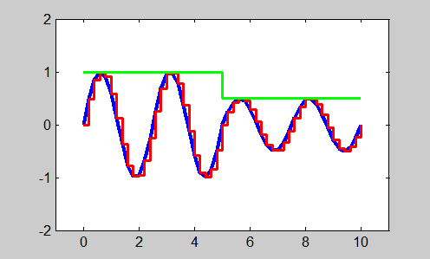
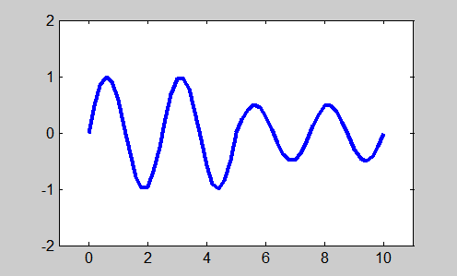
Simulation Modes
Continuous: variable-step size
Accurate: step size shrinks to capture events
Speed depends on # of continuous states and dynamics
Discrete: fixed-step size
Fewer computations per step
Very scalable, good for large systems
Phasor: simplified set of equations
Uses algebraic equations to represent voltage and current as phasor
Very fast, but solution only at a specific frequency
Continuous
Discrete
Phasor

Slide 15
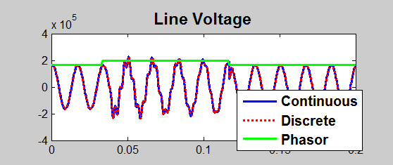
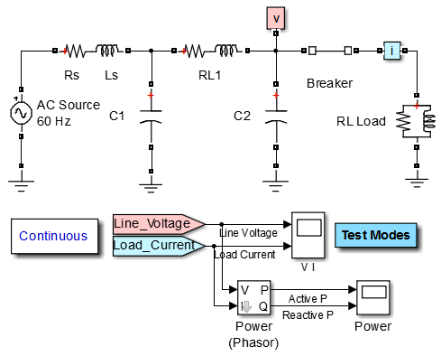
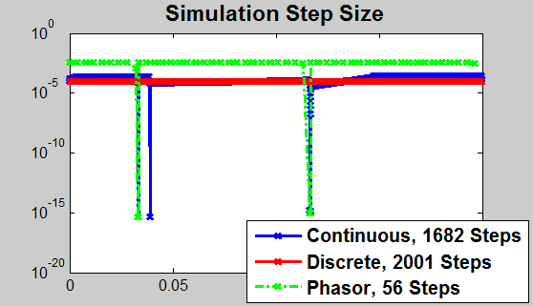
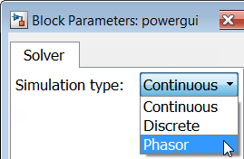
Selecting Simulation Mode
Situation:
Problem: Analyze transient effects and magnitudes of circuit voltages
Solution: Select the SimPowerSystems™ simulation mode that is appropriate for the analysis

Slide 16
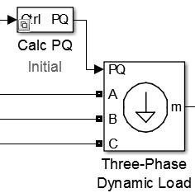
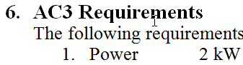
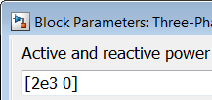
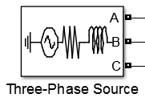
Generic Abstract Model AC Loads, Sources
Dynamic Load provides generic abstract model
Specify active and reactive powers by signal or voltage sequence
Use to define source or load
Define initial abstract model based on requirements
Ideal source enables calculation of generator requirements

Slide 17
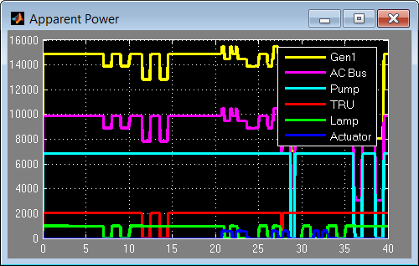
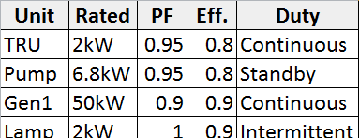
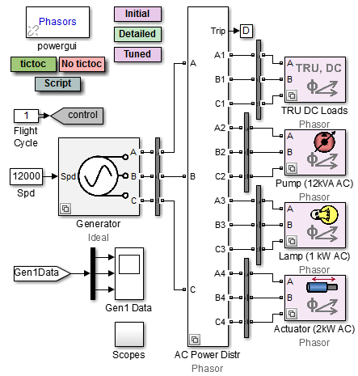
Refining Power Requirements for Generator, Lines
1
Situation:
2
3
4
5
6
Loads On/Off
Cycle 1
3
Cycle 2
…
…
Hours
Problem: Refine initial requirements by testing a wide range of conditions
Solution: Use abstract loads, sources, and phasor simulation to refine power requirements
1
4
2
5
6

Slide 18
Agenda
Overview: Aircraft Power Network Model
Simulation goals
Development process
Initial Design
Linking to Requirements
Refining Requirements
Detailed Design
Generators, Loads
Harmonic analysis
Integrating other domains
Tuning Abstract Model
Documenting Results
REQUIREMENTS
1
2
SYSTEM LEVEL MODEL
DETAILED
Mechanical
Electrical
3
Electrical
Control
ϕ

Slide 19
Aircraft Power Generation Options
Integrated Drive Generator
Several options currently in use (commercial, military)
Common components:
Generator
Power electronics to convert power
400 Hz
AC
Constant
Speed Drive
VSCF¹ Gen., Cycloconverter
Cyclo- conv.
400 Hz
AC
Variable Frequency Generator
VSCF Gen., DC Link
400 - 800 Hz
AC
DC
400 Hz
AC
¹Variable Speed Constant Frequency

Slide 20
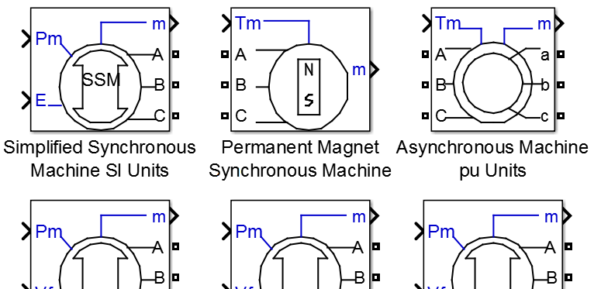
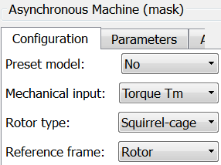
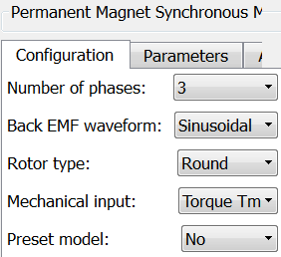
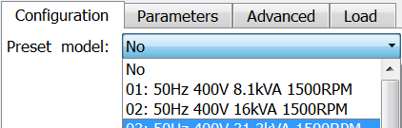
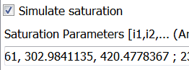
Power Generation Machines Library
Many types provided
Synchronous, Asynch., PMSM…
Excitation models (AC1A, etc.)
Many parameterization options
Types, phases, inputs …
Preset models
Enable/Disable effects

Slide 21
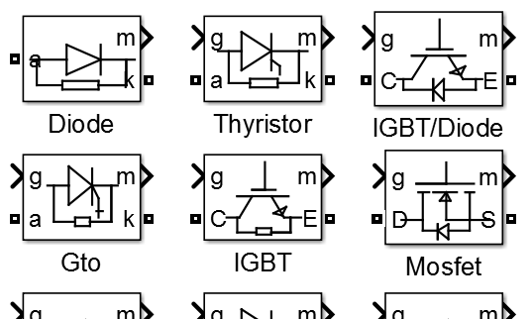
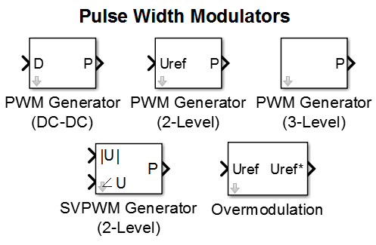
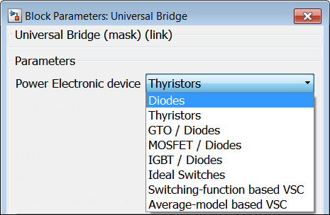
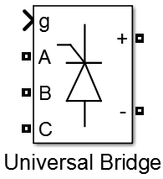
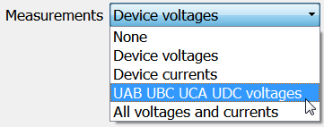
Power Electronics
Many devices provided
Diode, thyristor, IGBT, MOSFET
PWM and signal generators
Configurable bridges
Select device type
Switching function and Average-model options for increased speed
Log internal measurements

Slide 22
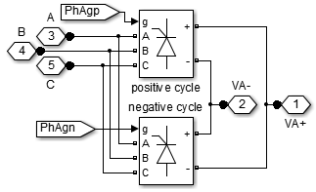
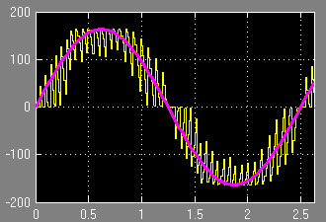


Modeling Power Generation
Situation:
Cyclo- conv.
400 Hz
AC
Turbine (variable speed)
400 Hz
AC
DC
Problem: Evaluate options for generating AC power for network
Solution: Use SimPowerSystems to model, simulate, and evaluate options

Slide 23








AC Loads
Options for AC loads include:
RLC loads and branches
Transformers
Machines
Drives (machine + converter + control)
Many configuration options
Configurations and fidelity

Slide 24



Analyzing Power Quality Total Harmonic Distortion (THD)
Loading can cause distortion of supply voltage waveform
Effects of poor power quality
Heating in generator
High neutral currents
Unnecessary switching in power electronics
THD provides a measure of AC power quality
Important to measure under varying network conditions
Easy to calculate with MathWorks products

Slide 25


Analyzing Power Quality
Situation:
GEN
Voltage
AC Bus
AC1
AC2
AC3
TRU
Loads On/Off
DC Bus
1
2
DC1
DC2
DC3
Batt
…
Hours
Problem: Evaluate power quality within network under various conditions
Solution: Use SimPowerSystems and MATLAB to automate calculation of total harmonic distortion (THD)

Slide 26



DC Loads
Pure electrical and multidomain options
Multidomain
Electrical + Thermal
Electrical + Mechanical + Hydraulic

Slide 27


Modeling Physical Systems
Simscape
Mechanical
Hydraulic
Electrical
Foundation library of physical elements
Mechanical, hydraulic, electrical…
Create custom components using Simscape™ Language
Thermal
Pneumatic
Magnetic
N
S
Custom Domains via Simscape Language
A
B
T
P

Slide 28
Simscape Add-on Libraries
SimPowerSystems
SimMechanics
SimHydraulics
SimDriveline
SimElectronics
SimDriveline™
Gears, leadscrew, clutches, tires, engines
SimElectronics®
Actuators, sensors, and semiconductors
SimHydraulics ®
Pumps, actuators, pipelines, valves, tanks
SimMechanics™
Multibody systems: joints, bodies, frames
SimPowerSystems™
Three-phase electrical networks
Simscape
MATLAB, Simulink
Simscape
Mechanical
Hydraulic
Electrical
Thermal
Pneumatic
Magnetic
N
S
Custom Domains via Simscape Language
Multidomain
physical systems

Slide 29
Agenda
Overview: Aircraft Power Network Model
Simulation goals
Development process
Initial Design
Linking to Requirements
Refining Requirements
Detailed Design
Generators, Loads
Harmonic analysis
Integrating other domains
Tuning Abstract Model
Documenting Results
REQUIREMENTS
1
2
SYSTEM LEVEL MODEL
DETAILED
Mechanical
Electrical
3
Electrical
Control
ϕ
4

Slide 30




AC Loads Tune Abstract Model
Need to refine initial abstract model to match detailed simulation results
Specify active and reactive powers using input signal
Tune to match behavior of detailed design
Initial Abstract Model
Tuned Abstract Model

Slide 31







Tuning Abstract Models to Match Detailed Results
Situation:
DETAILED
Active Power
Control Signal
Reactive Power
ABSTRACT
Active Power
ϕ
Reactive Power
Problem: Result from abstract model do not match detailed simulation results
Solution: Use Simulink Design Optimization to automatically tune model parameters
slope | step_down | q_scaling
2432 | 452.3 | 0.2713
slope | step_down | q_scaling
792 | 250 | 0.72

Slide 32


Tuning Abstract Models to Match Detailed Results
Steps to Estimate Parameters
Import measurement data and select estimation data
Identify parameters and their ranges
Perform parameter estimation
Validate estimation
slope | step_down | q_scaling
792 | 250 | 0.72

Slide 33

Tuning Abstract Model
Video of Parameter Tuning

Slide 34

Distributing Simulations with Parallel Computing
Simulating in parallel
Distribute simulations to multiple cores/processors
Dramatic speedup for sets of simulations (parameter sweeps, flight cycles optimizations, and more)
Network Model
Computer Cluster
Desktop System
Workers
Workers
Simulation 1
Simulation 2
…
…
…
…
…
for parfor
Running simulations in parallel speeds up your testing process.

Slide 35

Accelerate Flight Cycle Tests Using Parallel Computing
Model:
GEN
AC Bus
Flight Cycles
Faults
Equipment
Weather
…
AC1
AC2
AC3
TRU
DC Bus
DC1
DC2
DC3
Batt
Problem: Test system performance under a range of conditions (flight cycles, faults, weather, etc. )
Solution: Use Parallel Computing Toolbox™ to speed up the set of tests
Multi
Core
Parameter Set 1
Parameter Set 2
…
Parameter Set N

Slide 36


Accelerate Flight Cycle Tests Using Parallel Computing
Multi
Core
Steps to compare simulation methods
1. Open pool of MATLAB sessions
2. Generate parameter sets
3. Run simulations serially
4. Run simulations in parallel
Parameter Set 1
>> matlabpool
Parameter Set 2
…
Flight_Cycle_array = [1:8];
Generate_Sim_Settings
Parameter Set N
for i = 1:numSims
out{i} = sim(mdl, SimSettings{i});
end
parfor i = 1:numSims
out{i} = sim(mdl, SimSettings{i});
end

Slide 37
Agenda
Overview: Aircraft Power Network Model
Simulation goals
Development process
Initial Design
Linking to Requirements
Refining Requirements
Detailed Design
Generators, Loads
Harmonic analysis
Integrating other domains
Tuning Abstract Model
Documenting Results
REQUIREMENTS
1
2
SYSTEM LEVEL MODEL
DETAILED
Mechanical
Electrical
3
Electrical
Control
ϕ
4

Slide 38






Automatically Run Tests And Document Results
Situation:
C and MATLAB
Code
Test
Screenshots
Network Model
Design Change
Document
Simulation 1
Simulation 2
Report
Evaluate Results
…
✗ Fail
✓Pass
Plots and Results
Problem: Evaluate test results quickly to make design changes and document the results
Solution: Use Simulink Report Generator to automatically document tests and results

Slide 39
Key Points
Computational Time vs. Model Complexity
Configure your model to balance model fidelity and simulation speed
Accelerate your simulations using optimization algorithms and parallel computing
Accelerate your development by automating simulation and analysis tasks using MATLAB
Computational
Time
Detail
Multi
Core
Network Model

Slide 41

Refine Requirements Example Generator and Line Sizing
Refine operating, peak, and design load requirements
1
3
2
1
4
3
2
5
4
6
5
6

Slide 42


Simulation Mode Example AC Circuit, Single Phase
Continuous, discrete, phasor
Compare results, speed

Slide 43



Synchronous Machine Example
Mechanical power as input
Constant power AC load
Use Load Flow to set initial conditions

Slide 44



Power Electronics Example AC-AC Conversion
VSCF Gen. with Cycloconverter
2 Universal Bridges per phase
AC-AC conversion
x3

Slide 45



Power Electronics Example AC-DC-AC PWM
VSCF Generator with DC Link
Rectifier, inverter with PWM
Diode measurements

Slide 46
Agenda
Overview: Aircraft Power Network Model
Simulation goals
Development process
Modeling
Power generation and distribution
Loads (AC, DC) and Battery Modeling
Tuning abstract models
Simulation
Modes (phasor/discrete, parallel simulations)
Harmonic analysis
Report generation

Slide 47


Analyzing Power Quality Example Calculating THD
Tools for calculating THD
Interactive GUI
Scripting function
During simulation

Slide 48


Modeling the Mechanical System
Model:
θ
Aileron
Problem: Model the mechanical system within Simulink
Solution: Use SimMechanics to model the aileron

Slide 49
DC System Battery
DC Bus
Battery
DC1
DC2
DC3
Challenge | Capability or Strategy
1. Hard to model exact electrochemical behavior | Approximate behavior with simplified equations or equivalent circuits
2. Multidomain, nonlinear effects are challenging to model | Use physical modeling tools to define equations and components
3. Model must simulate quickly to enable extensive testing (drive cycles, temperatures, etc.) | Include/neglect effects as needed to balance tradeoff of model fidelity and simulation speed
4. Model must provide results that compare well to test data | Use optimization algorithms to automatically tune parameter values until simulation results match test data
Challenge | Capability or Strategy
1. Hard to model exact electrochemical behavior | Approximate behavior with simplified equations or equivalent circuits
2. Multidomain, nonlinear effects are challenging to model | Use physical modeling tools to define equations and components
3. Model must simulate quickly to enable extensive testing (drive cycles, temperatures, etc.) | Include/neglect effects as needed to balance tradeoff of model fidelity and simulation speed
4. Model must provide results that compare well to test data | Use optimization algorithms to automatically tune parameter values until simulation results match test data
Modeling Methods
Tuning Capabilities

Slide 50




Battery Models: Generic, Pre-Defined
Generic
Charge dependent voltage source
Parameters found on data sheets
Pre-Defined
Several pre-defined models
Full parameterization
Documentation provides extensive detail

Slide 51




Battery Models: Custom Cell
Use supplied components or build new components via Simscape language
Battery cell equivalent discharge circuit
Resistors, capacitor, and voltage source are dependent upon SOC, DOC, and temperature

Slide 52




Simscape Language For Modeling Custom Components
MATLAB-based language, for text-based authoring of physical modeling domains, components, and libraries
Leverages MATLAB
Object-oriented for model reuse
Generate Simulink blocks
Save as binary to protect IP

Slide 53






Estimating Parameters Using Measured Data
Model:
A22 = Constant
Ao = Constant
Emo = Open Cir. Voltage
Qe_init = Initial Extr. Chg.
Ambient Temperature
Discharge Cycle
Battery Cell
Voltage
Problem: Simulation data does not match measured data because the parameters are incorrect
Solution: Use Simulink Design Optimization to automatically tune model parameters
A22 | Ao | Emo | Qe_init
-4 | -1 | 2 | 1.0e4
A22 | Ao | Emo | Qe_init
-9.99 | 0.402 | 2.20 | 3.84e4

Slide 54


Estimating Parameters Using Measured Data
Steps to Estimate Parameters
Import measurement data and select estimation data
Identify parameters and their ranges
Perform parameter estimation
Validate estimation
A22 | Ao | Emo | Qe_init
-4 | -1 | 2 | 1.0e4

Slide 55




Tuning Models Additional Strategies and Capabilities
Tune parameters in stages
Narrowing range for values
Tune sets of parameters
Tune with different data sets
Use scripting to automate tuning process
Accelerate parameter tuning by using parallel computing
Multi
Core

